Slide 1
Adversarial search

Slide 2
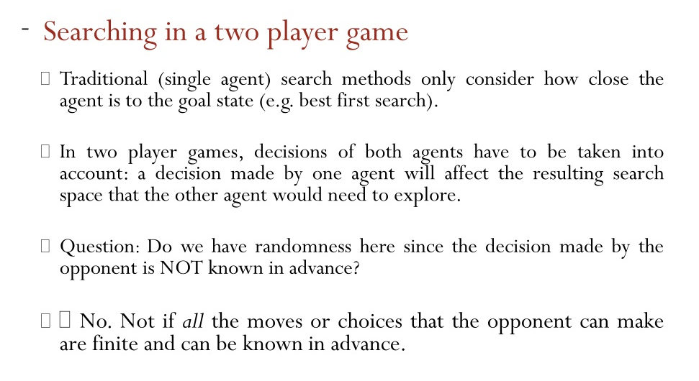
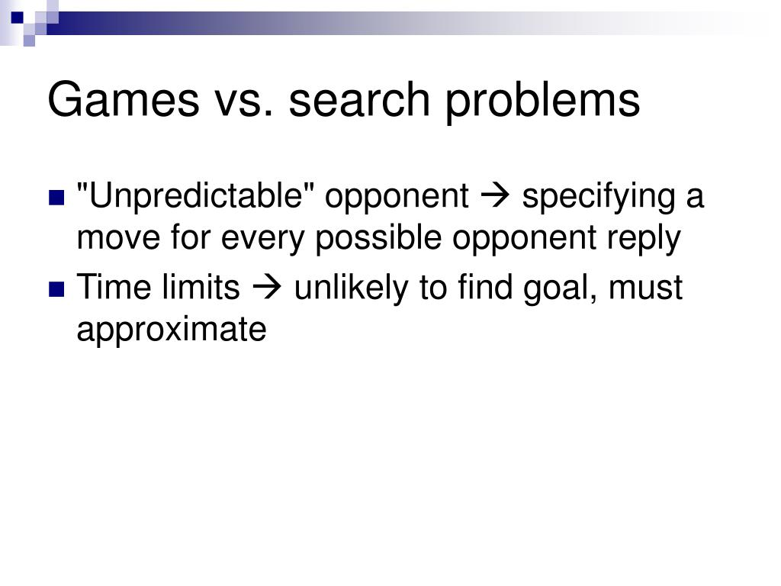

Slide 3
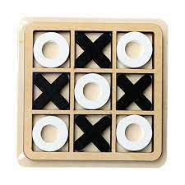
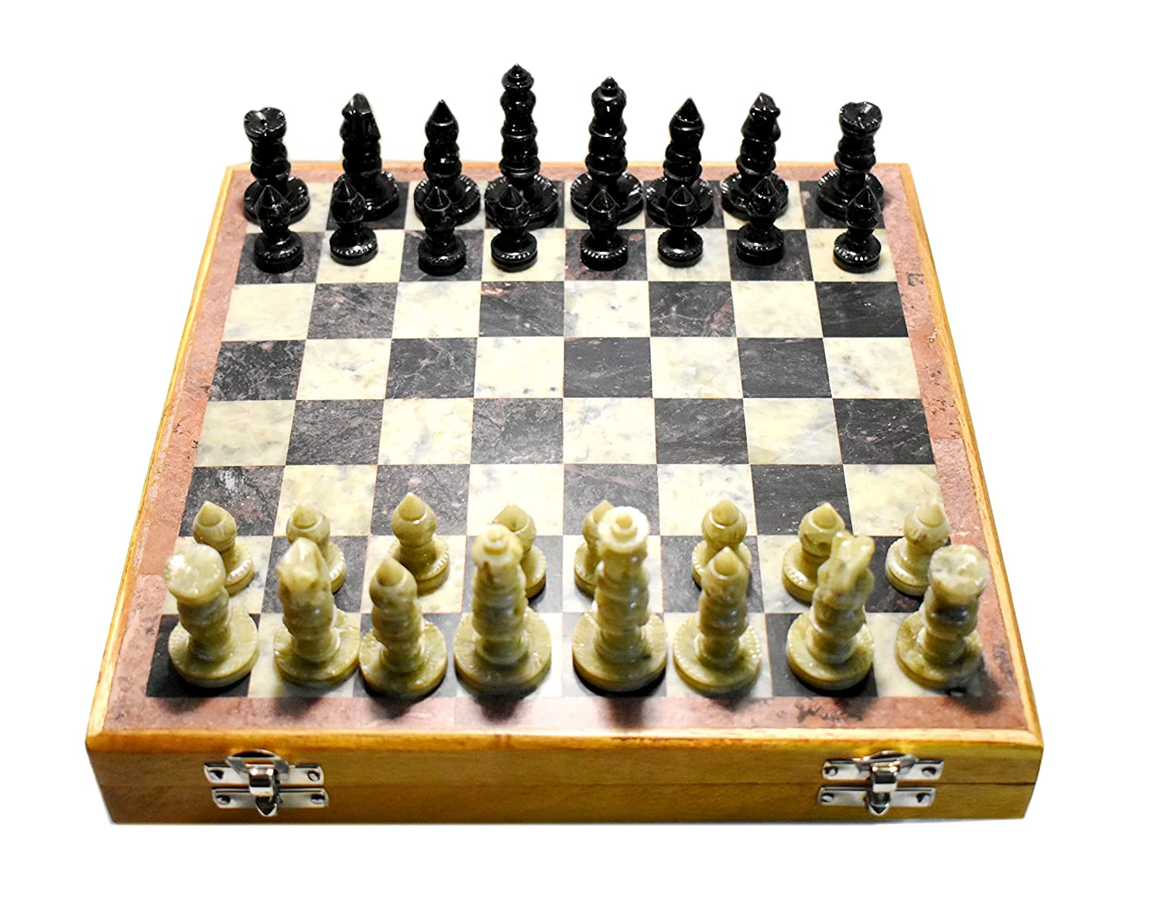
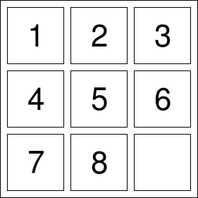
Adversarial Search
In previous topics, we have studied the search strategies which are only associated with a single agent that aims to find the solution which often expressed in the form of a sequence of actions.
But, there might be some situations where more than one agent is searching for the solution in the same search space, and this situation usually occurs in game playing.
So, Searches in which two or more players with conflicting goals are trying to explore the same search space for the solution, are called adversarial searches, often known as Games.

Slide 4
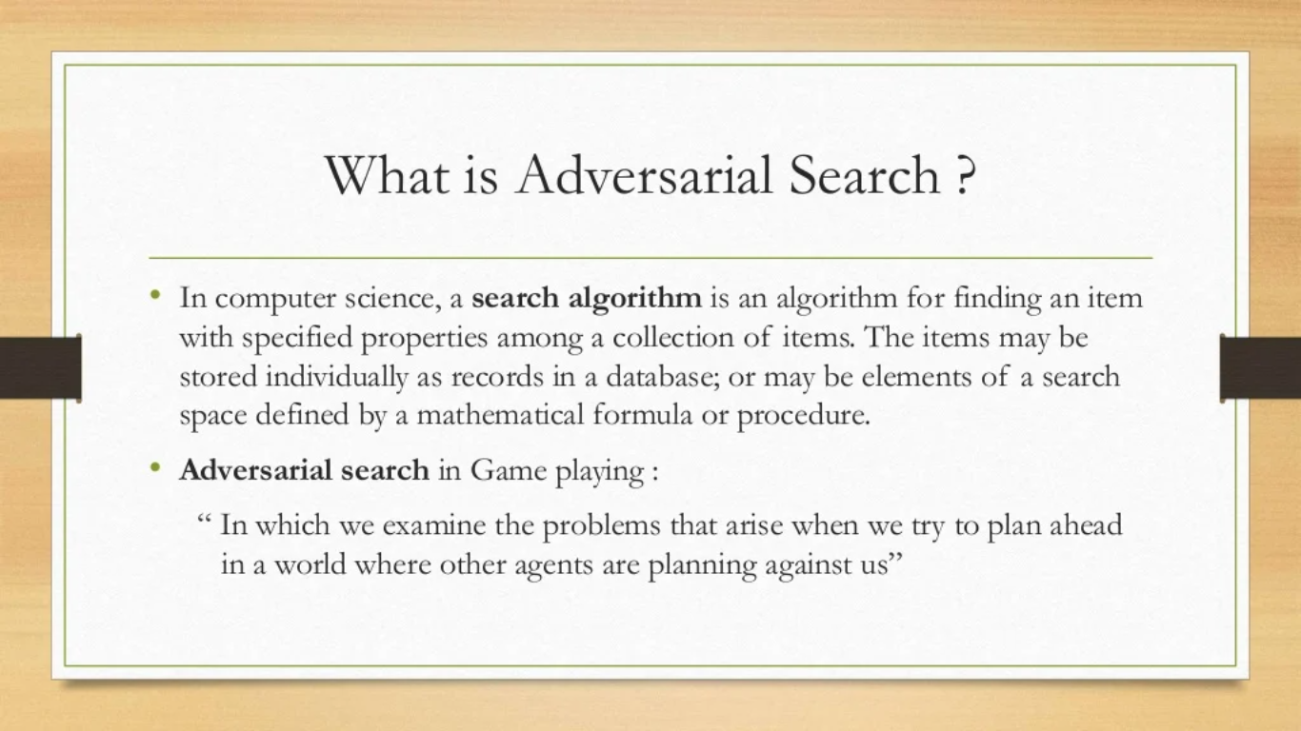

Slide 5
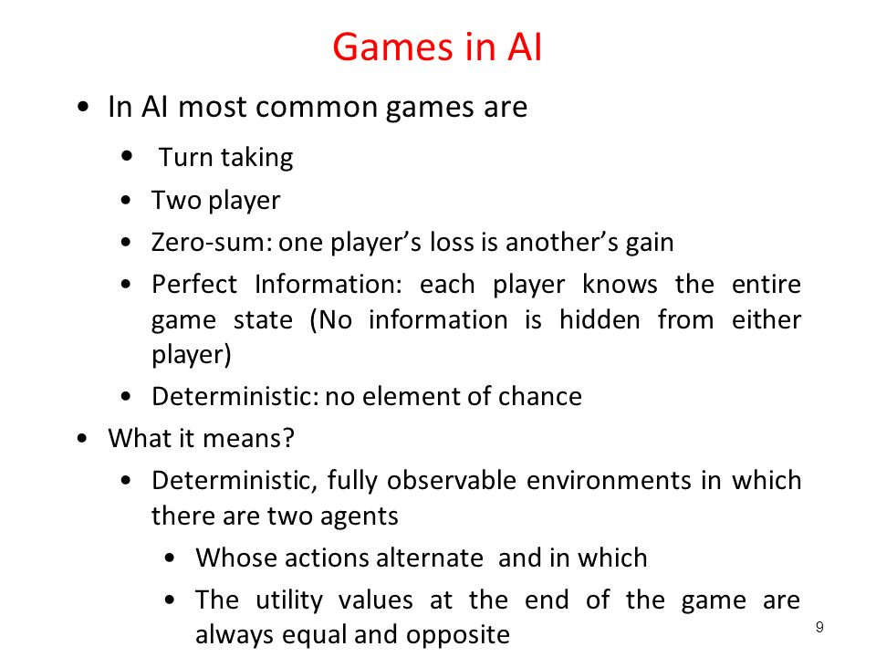

Slide 6
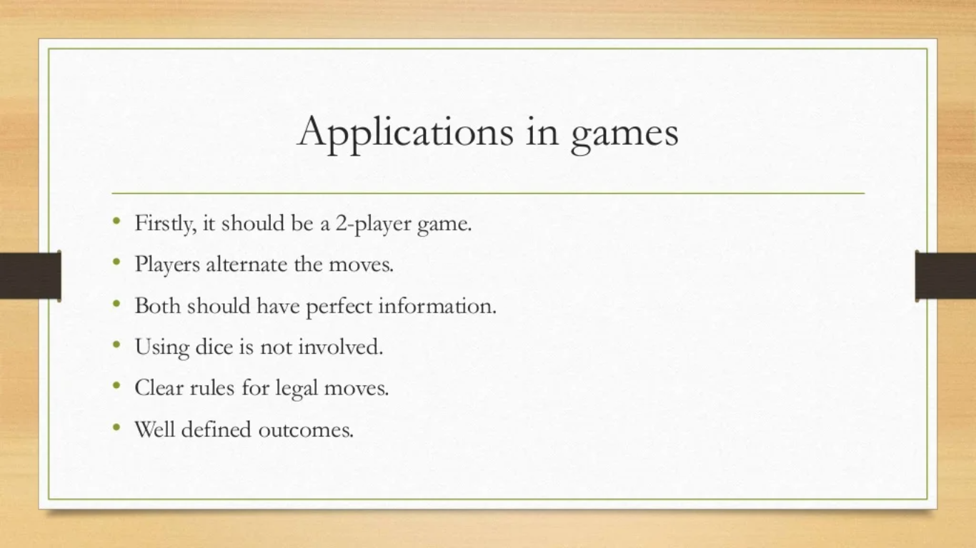
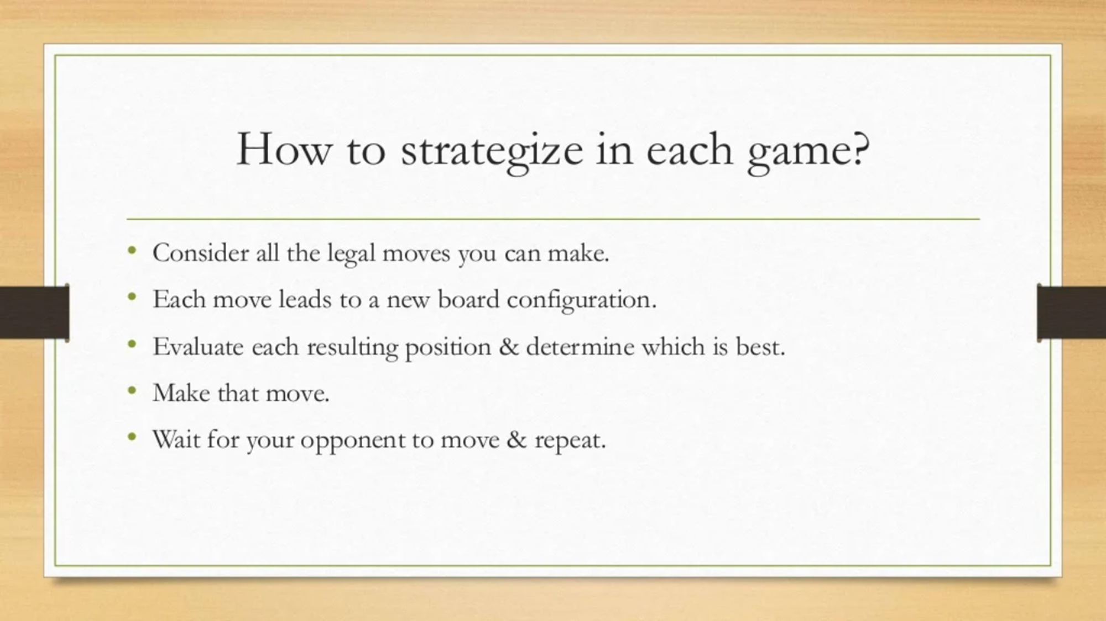
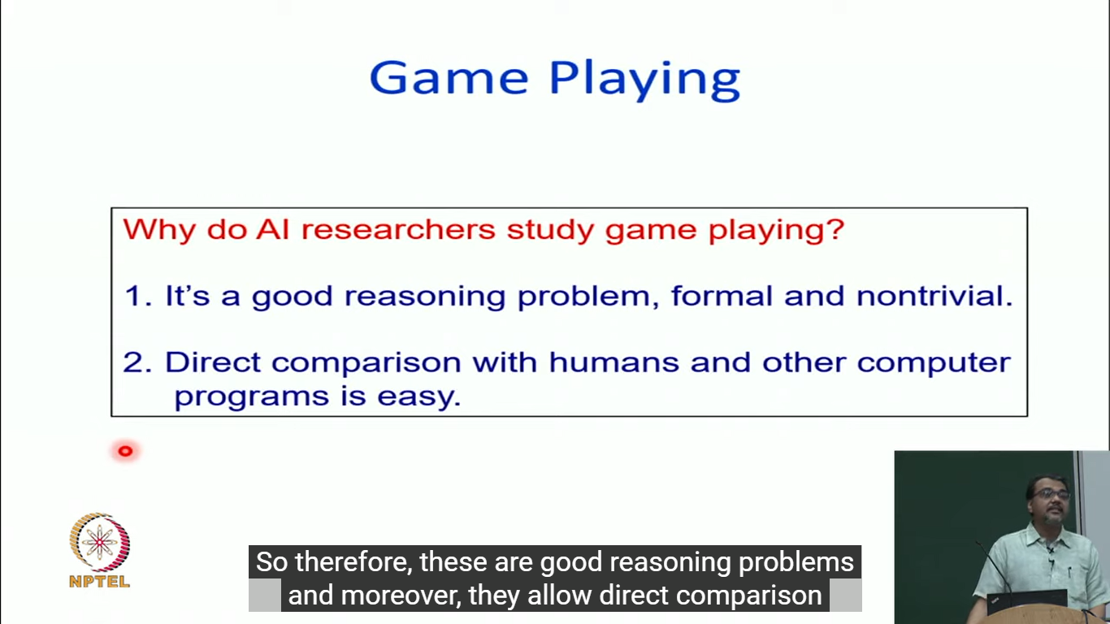

Slide 7
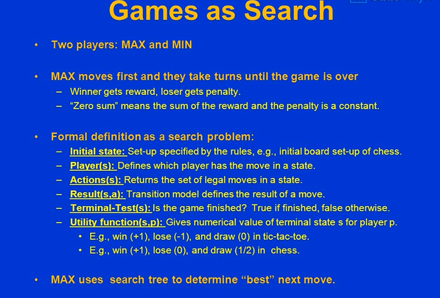

Slide 8
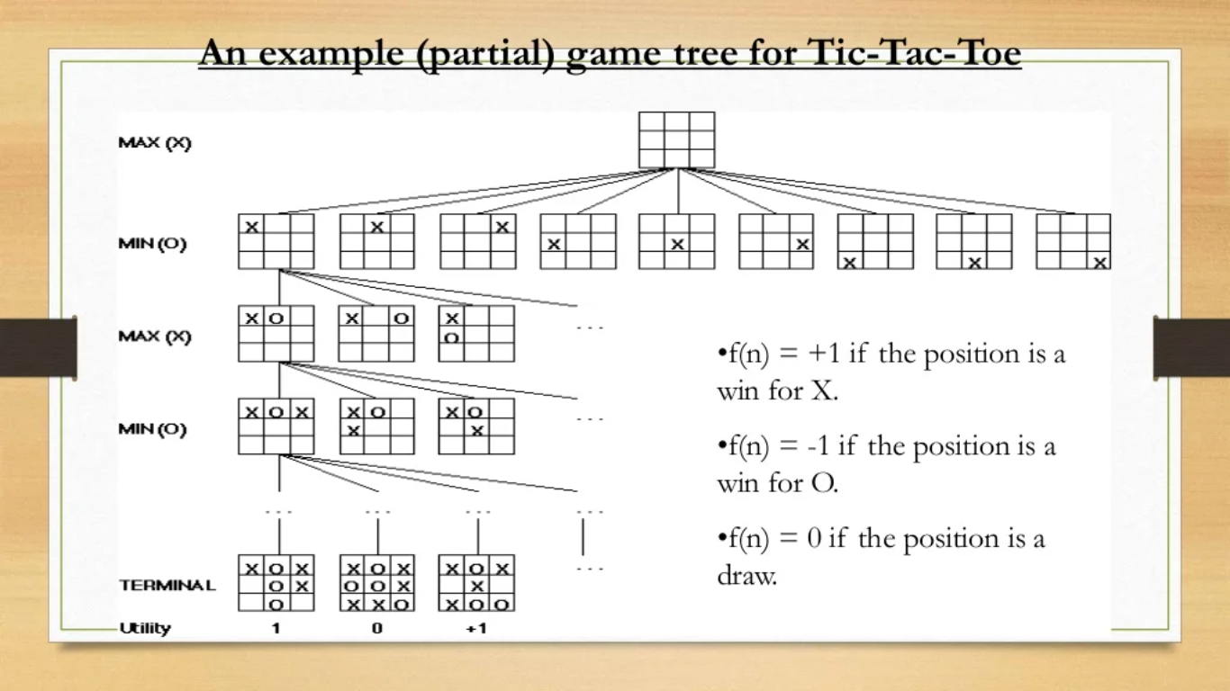

Slide 9
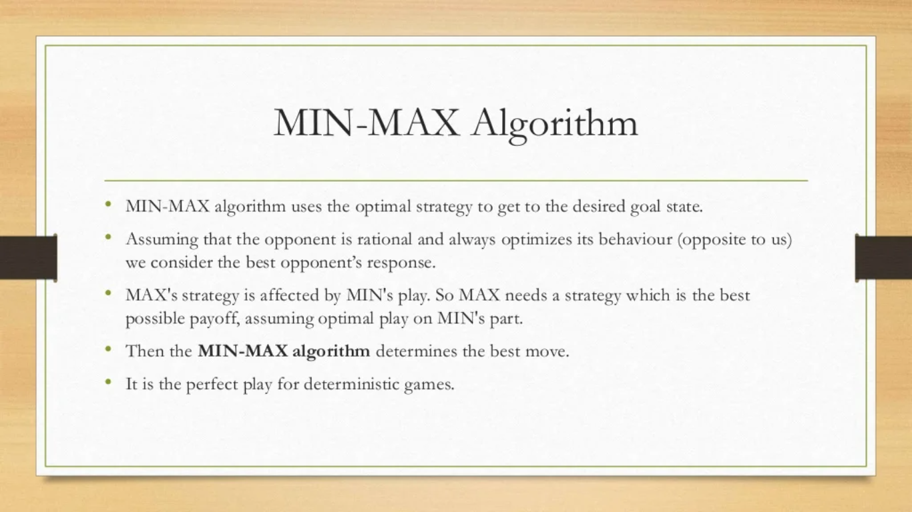

Slide 10
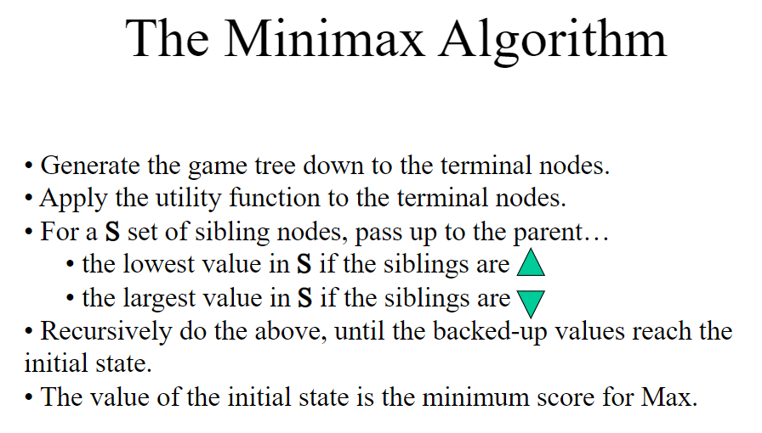

Slide 11
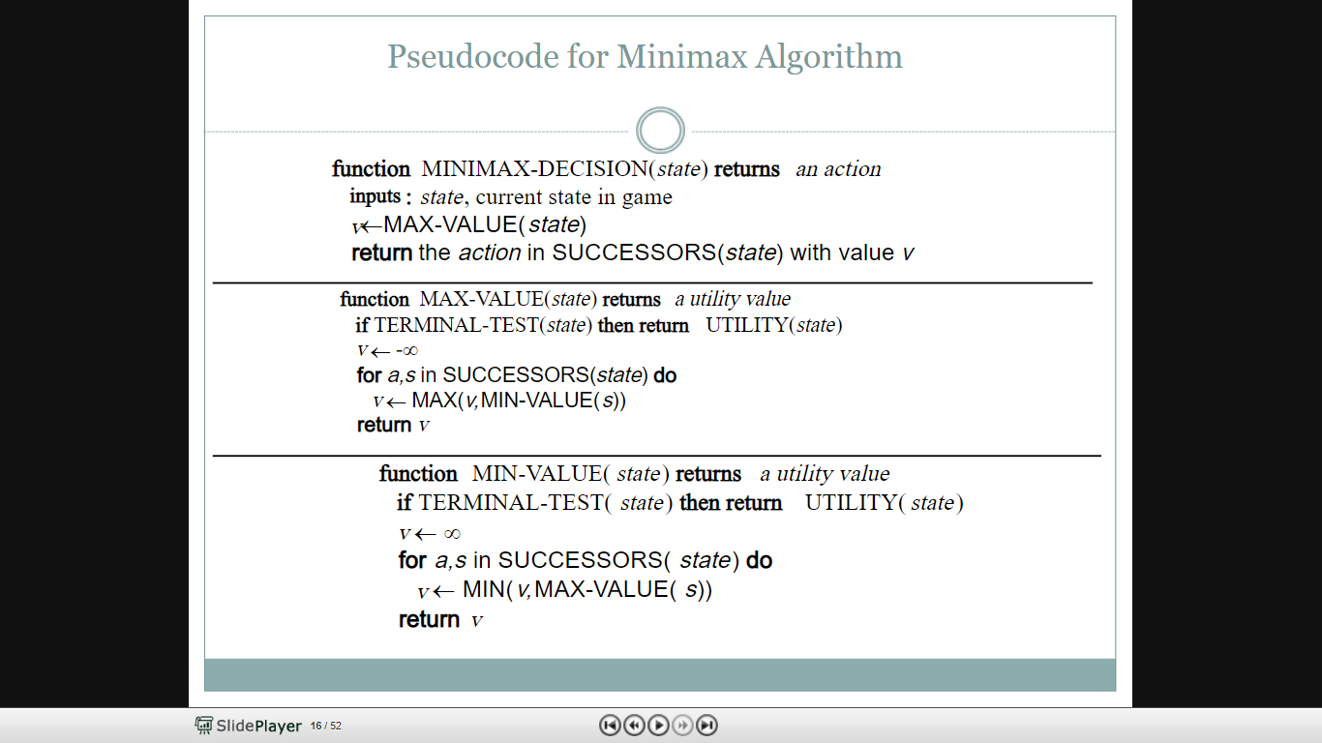

Slide 12
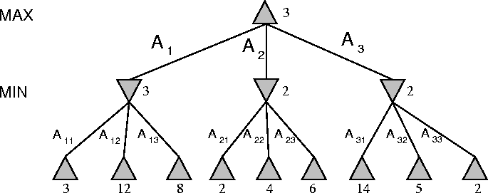
The minimax algorithm
The algorithm first recurses down to the tree bottom-left nodes
and uses the Utility function on them to discover that their values are 3, 12 and 8.
12

Slide 13
The minimax algorithm
A
B
Then it takes the minimum of these values, 3, and returns it as the backed-up value of node B.
Similar process for the other nodes.
13

Slide 14
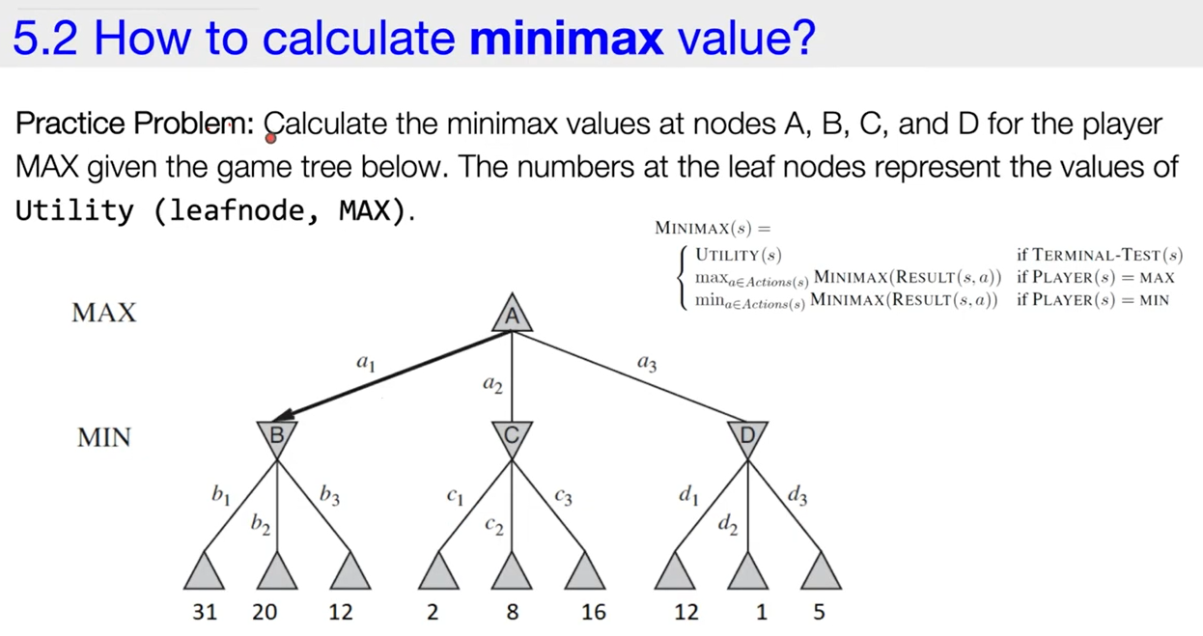

Slide 15
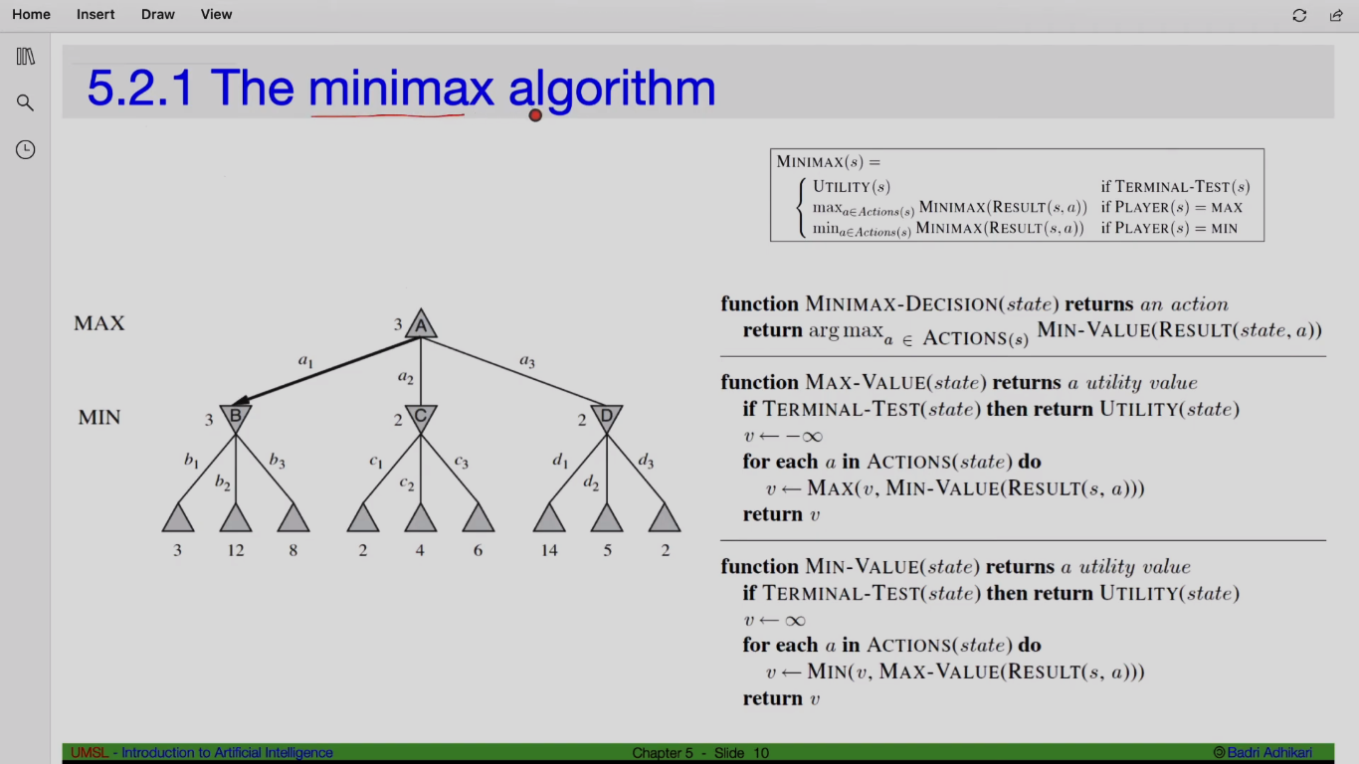

Slide 16
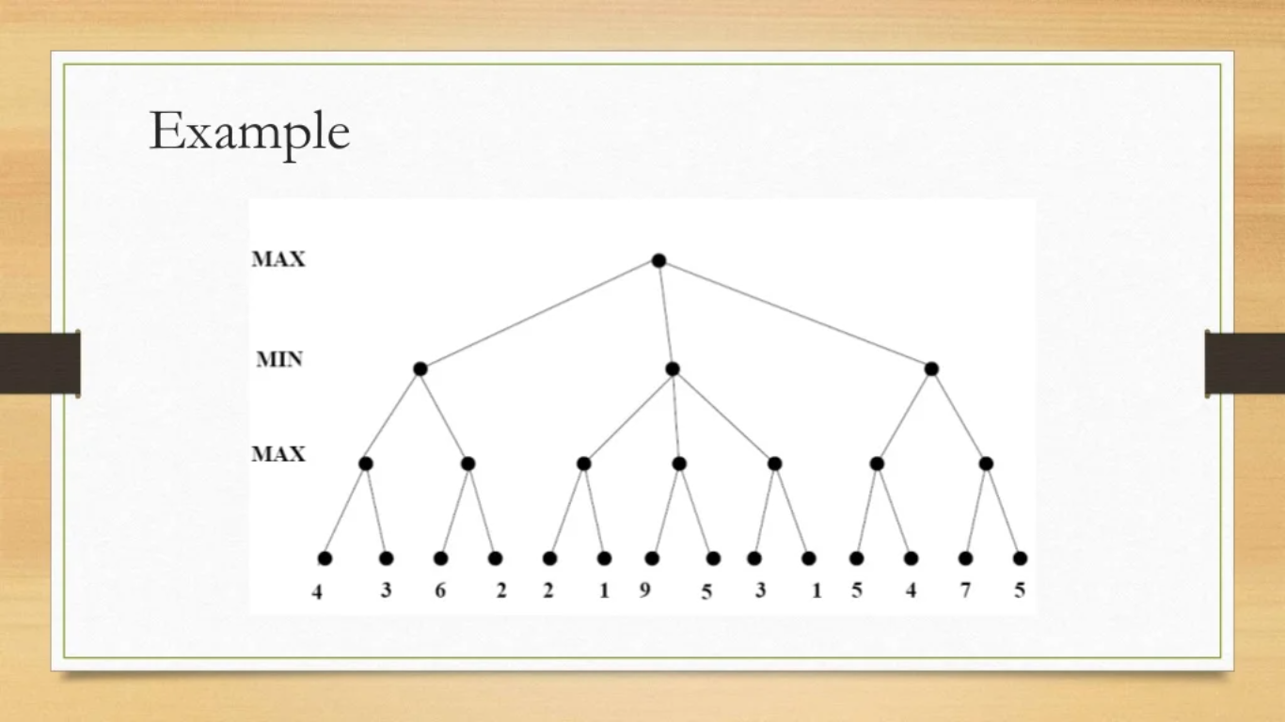

Slide 17
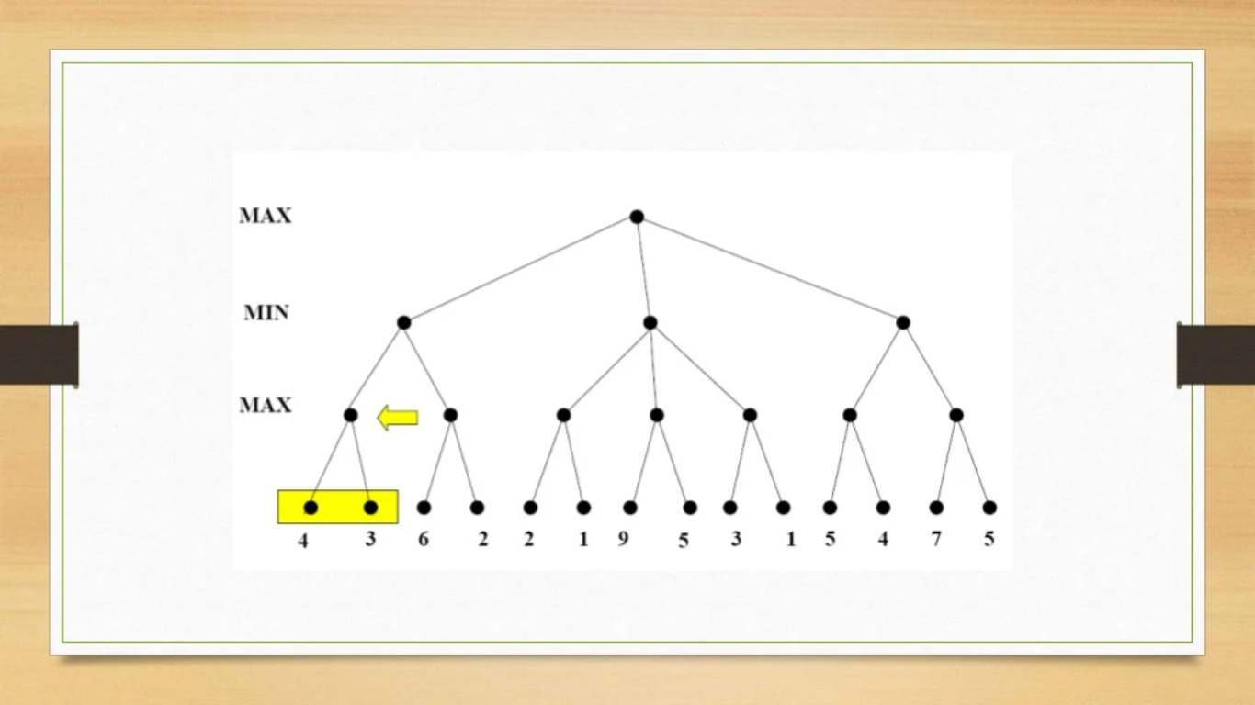

Slide 18
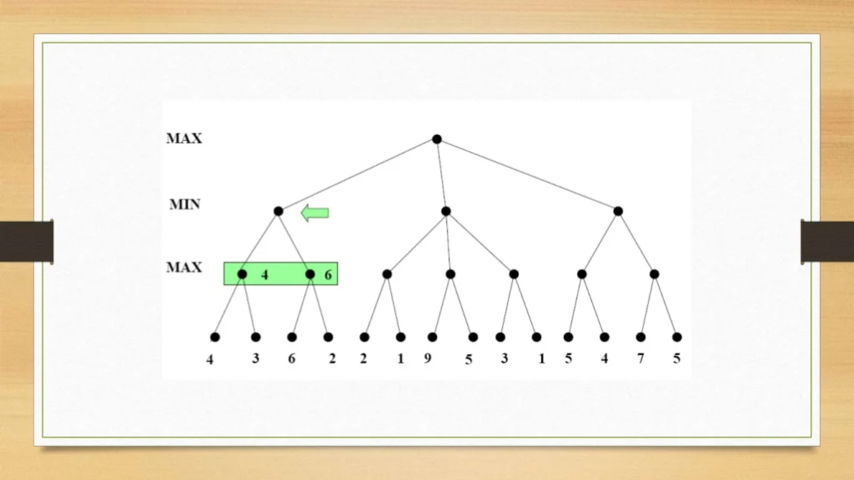

Slide 19
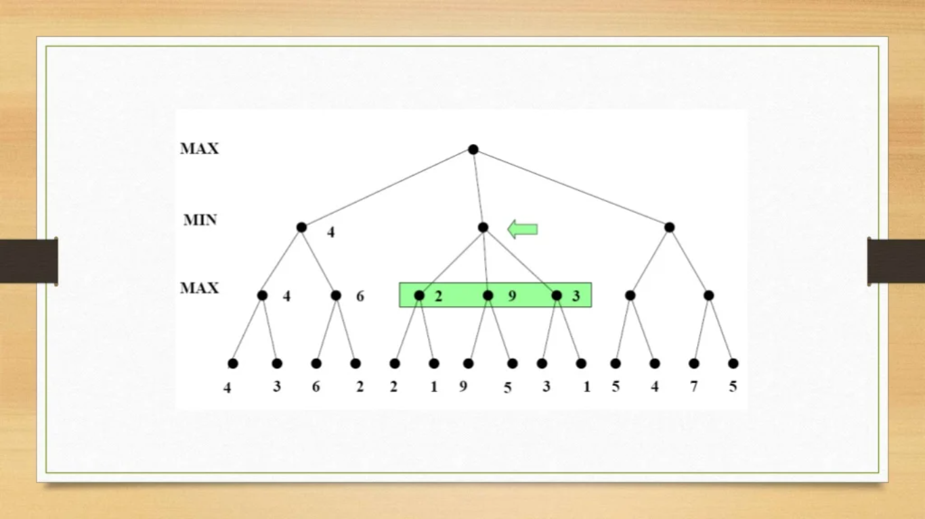

Slide 20
